Slide 1
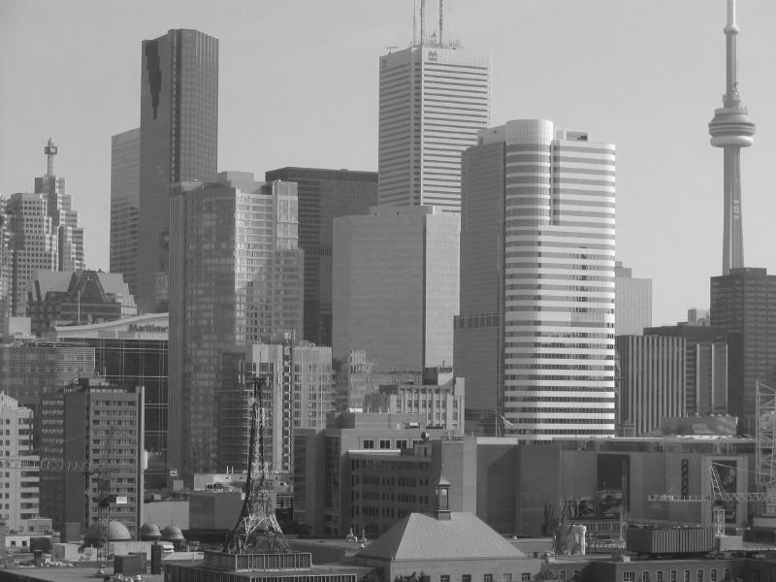
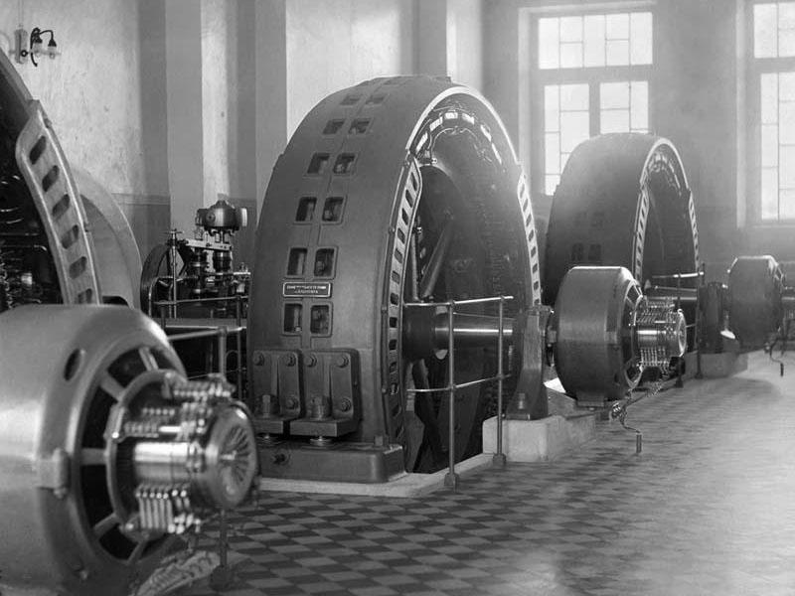
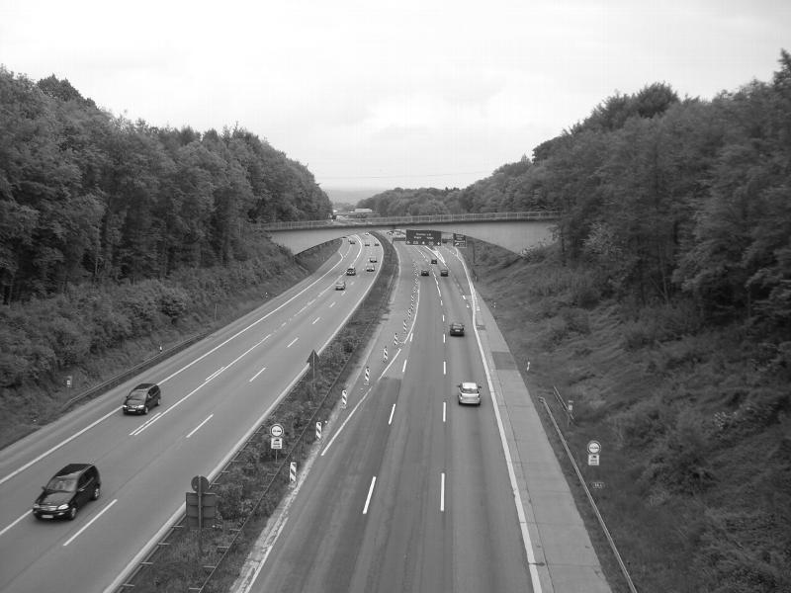

Slide 3

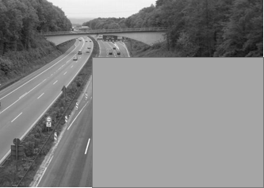
Near Group
Expect results
Example:
Single Trial
Average Block
Train
Test
city
road
City_near
Road_near
City_near
Factory_near
Factory_near
Road_near
1. Train: City_full vs Road_full
2. Train: City_full vs Factory_full
3. Train: Factory_full vs Road_full
Test: City_near+ Factory_far vs Road_near+ Factory_far
Test: City_near+ Road_far vs Factory_near+ Road_far
Test: Factory_near + City_far vs Road_near + City_far

Slide 4
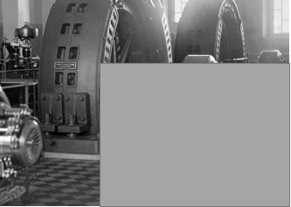
Far Group
Expect results
Single Trial
Average Block
Train
Test
city
road
City_far
Road_far
City_far
Factory_far
Factory_far
Road_far
1.Train: City_full vs Road_full
2.Train: City_full vs Factory_full
3.Train: Factory_full vs Road_full
Test: City_far + Factory_near vs Road_far+ Factory_near
Test: City_far + Road_near vs Factory_far + Road_near
Test: Factory_far + City_near vs Road_far + City_near

Slide 5
Plan B

Slide 6
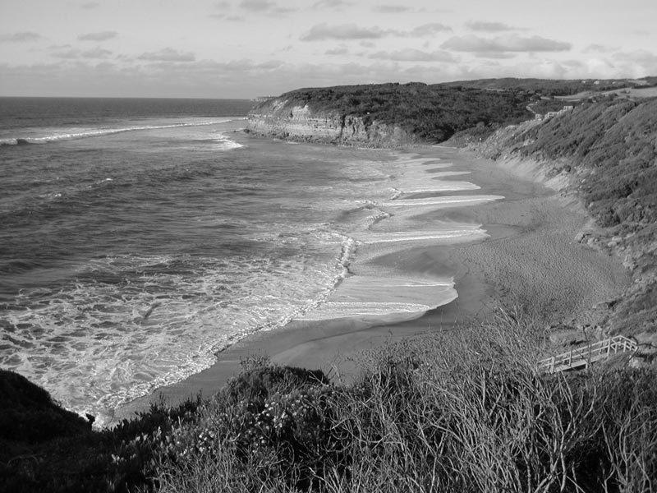
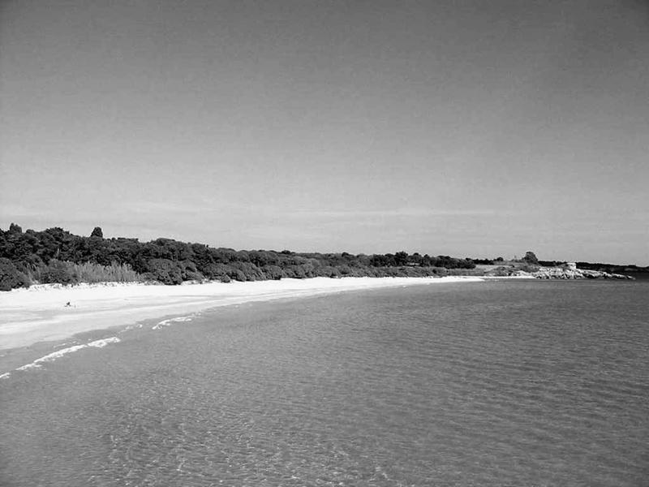
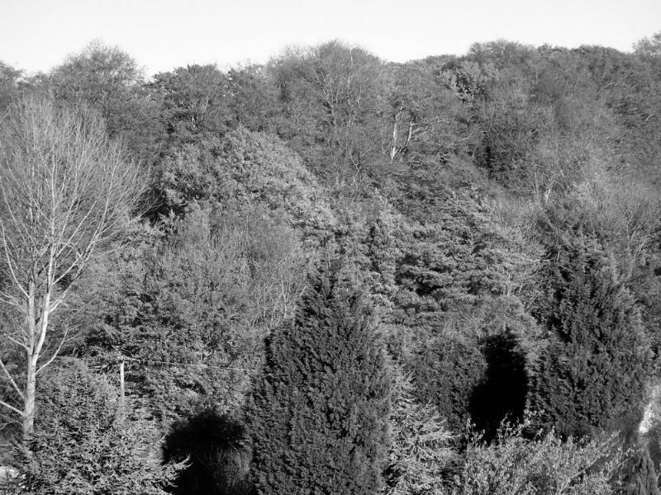
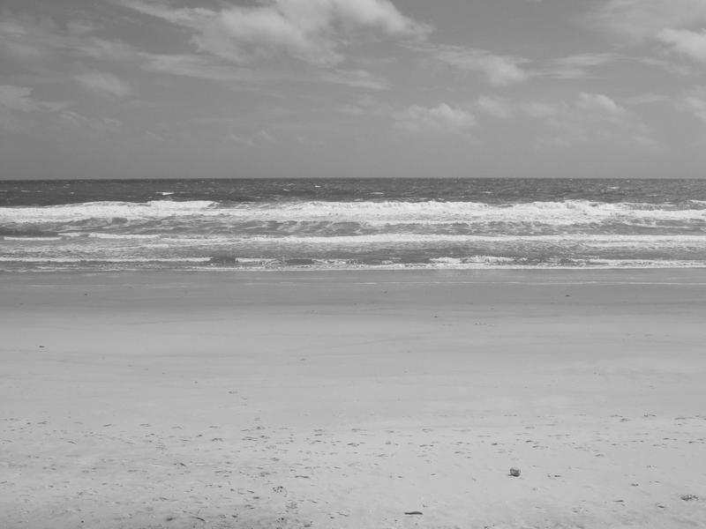
Stimuli
A
B
Noise stimuli
Two Stimuli: City, Factory
Noise Stimuli: images from other two categories with no same elements from A, B (such as beaches, forests)

Slide 7



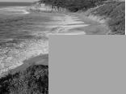
Conditions
*Random noise stimuli
Full image
City
Factory
Full ¾ image
City
Factory
Near + Noise
City_near + noise
Factory_near + noise
Far + Noise
City_far + noise
Factory_far+noise
8 trial types

Slide 9
MVPA (linear SVM)

Slide 10
Whole groups (far + near)
Expect results
Train (full image)
Test (3/4 image)
Single Trial
Average Block
Train full image
Test ¾ images
Train ¾ images
Test full image
Also, Train ¾ images Test full image

Slide 11
Near Group
Expect results
Example:
Train
Test
city
road
Train ¾ images Test near+Noise
Train near+noise
Test ¾ images
¾ images
Near+Noise

Slide 12
Near Group
Expect results
Example:
Train
Test
city
road
Train Full images Test near+Noise
Train near+noise
Test Full images
Full images
Near+Noise

Slide 13
Far Group
Example:
Expect results
Train
Test
city
road
Train ¾ images Test Far+Noise
Train Far+noise
Test ¾ images
¾ images
Far+Noise

Slide 14
Far Group
Example:
Expect results
Train
Test
city
road
Train Full images Test Far+Noise
Train Far+noise
Test Full images
Full images
Far+Noise

Slide 15
If it is possible…..
We could also categorise noises, then train/test:
Like:
Train: Forest + city vs Forest + factory
Test: Beach + city vs Beach + Factory, city-full vs factory_full, city_3/4 vs factory_3/4
Train: Forest + city vs Beach + factory
Test: Forest + Factory vs Beach + city, city_full vs factory_full, city_3/4 vs factory_3/4

